Slide 1
LAB 3: DML Queries
JOINS and AGGREGATION

Slide 2
What is a join?
SQL allows you to cross reference information between tables.
There are two methods to do this:
Compare & Contrast: Compare values in a given table against another and get a matching pair result table from the data.
JOIN: Join the two tables into a temporary table based on some rules.

Slide 3
Example Movie DB
The Movie DB schema…
Inventory (TapeID,MovieID)
Movies (MovieID, MovieName)
Suppliers (SupplierID, SupplierName)
MovieSupplier (SupplierID, MovieID, Price)
Orders (OrderID, SupplierID, MovieID, Copies)
This database is for a movie company. This database keeps track of the possible movies available on video. This database also keeps track of different suppliers in the company and the videos they have ordered.

Slide 4
A. Compare & Contrast Tables
This is done by putting a statement in the WHERE clause of a query.
This will simply compare the two tables and add the matching pairs to the result set.
Example: Give me the list of all the movies in the inventory.
SELECT DISTINCT M.MovieName
FROM Movies M, Inventory I
WHERE M.MovieID = I.MovieID
More like using the Cartesian Product operator and then looking to compare values using the ’=‘ condition

Slide 5
B. SQL Command: JOIN
We introduce the types of joins SQL offers
NATURAL JOIN
JOIN … ON (or INNER JOIN … ON)
LEFT JOIN … ON
RIGHT JOIN … ON
NATURAL JOIN
Does the same thing as compare & contrast.
Syntax : <Table1> NATURAL JOIN <Table2>
Attributes with the same name of associate tables will be used to join the tables.
Common Attributes occur just once.
Outer joins of Relational Algebra

Slide 6
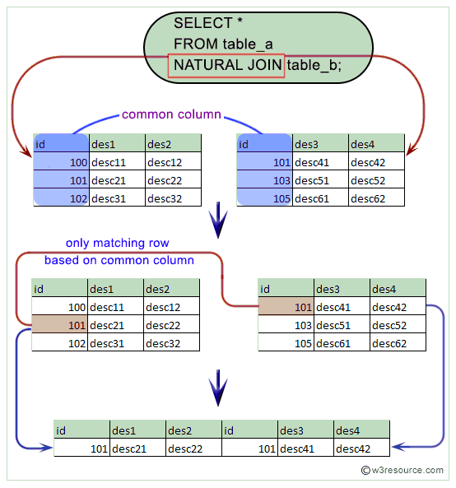
NATURAL JOIN
https://www.w3resource.com/mysql/advance-query-in-mysql/mysql-natural-join.php

Slide 7
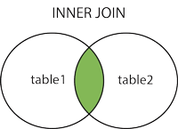
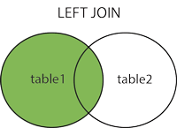
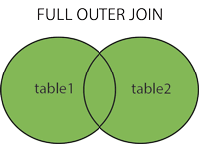
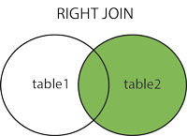
SQL Command: JOIN
There are two classes of JOINs in MySQL.
INNER
OUTER

Slide 8
C. What about JOIN or INNER JOIN?
JOIN…ON (or INNER JOIN…ON)
Does the same thing as NATURAL JOIN.
Syntax : <Table1> [INNER] JOIN <Table2> ON <Condition>
Can handle multiple conditions for joining tables using AND clause
Can handle user specified attributes using the USING clause

Slide 9
D. What about OUTER JOINS: LEFT JOIN / RIGHT JOIN
Idea of these Joins
The result table comes from two tables...the table to the LEFT and the table to the RIGHT of the JOIN
Syntax:
LEFT JOIN...ON Syntax
<Left Table> LEFT JOIN <Right Table> ON <Condition>
RIGHT JOIN…ON Syntax
<Left Table> RIGHT JOIN <Right Table> ON <Condition>

Slide 10
Using Outer JOINS
STEP 1: Syntax is like an <INNER> JOIN...
LEFT JOIN Syntax
<Left Table> LEFT JOIN <Right Table> ON <Condition>
RIGHT JOIN Syntax
<Left Table> RIGHT JOIN <Right Table> ON <Condition>
STEP 2: After results generated useful if you’re looking for non-matching pairs...
IS NULL
This can be used in the WHERE clause to check if an attribute to some record has a null value.
IS NOT NULL
This also can be used in the WHERE clause...

Slide 11
Example
MOVIES
MOVIEID MOVIENAME
1 STAR WARS
2 EMPIRE STRIKES BACK
3 RETURN OF THE JEDI
INVENTORY
TAPEID MOVIEID
1 1
2 3
3 3
Given...
QUERY: List movie titles are not in the movie inventory
First Try...
SELECT *
FROM Movie M LEFT JOIN Inventory I ON M.MovieID = I.MovieID;
Gives the result...
MOVIEID MOVIENAME TAPEID
1 STAR WARS 1
3 RETURN OF THE JEDI 2
RETURN OF THE JEDI 3
2 EMPIRE STRIKES BACK NULL

Slide 12
Answer & A New Question...
What movie titles are not in the movie inventory?
Second Query Try...only look for the null valued answers...
SELECT *
FROM Movie M LEFT JOIN Inventory I ON M.MovieID = I.MovieID
WHERE I.TapeID IS NULL;
Gives the result...
Thus, just change the SELECT statement to what you want, and you’re done!
MOVIEID MOVIENAME TAPEID
2 EMPIRE STRIKES BACK. NULL
Try this query...
Question: What are the names of the movies in the movie inventory?
(Hint: Do I have to watch for duplicates?)

Slide 13
What is aggregation?
Aggregation is the ability to do simple mathematical functions on groups of data in the result table.
Methods provided in MySQL...
SUM : Adds up any grouped values
MIN : Finds the smallest value in the set given
MAX : Finds the largest value in the set given
AVG : Finds the mean value of the set given
COUNT : Counts the number of records in the set given
To understand how to use aggregation, you must understand how a query is executed...

Slide 14
Understanding a Query...
Query Format
SELECT <Column Name(s)>
FROM <Tables/Joined Tables>
WHERE <Condition(s)>
GROUP BY <Column Name (s)> HAVING <Having Clause>
Execution Order of the Query...
1st: It finds the tables/joined tables it needs in the FROM clause.
2nd: It evaluates row actions defined in the WHERE clause to produce a temporary result table.
3rd: It uses the GROUP BY and HAVING definitions to know what further actions to take.
4th: It uses the SELECT clause to know what rows to show.

Slide 15
Aggregation cont.
This can be used in the SELECT or HAVING clause...
Question: What is the average price of a movie?
SELECT AVG(Price) AS Average_Price
FROM MovieSupplier;
Question: What movie suppliers have a movie that costs less than $9?
SELECT DISTINCT S.SupplierName
FROM MovieSupplier MS JOIN Supplier S ON S.SupplierID = MS.SupplierID
GROUP BY MS.SupplierName HAVING MIN(MS.Price) < 9.00;

